Slide 1
Designing Database Solutions for SQL Server
Christian Bolton | Technical Director, Coeo
Graeme Malcolm | Microsoft

Slide 2
Course Topics
Designing Database Solutions for SQL Server
01 | Managing a SQL Server Environment
02 | Designing Database Security
03 | Designing a Backup & Recovery Solution
04 | Designing a High-Availability Solution
05 | Troubleshooting & Maintaining a database

Slide 3
02 | Designing Database Security
Christian Bolton | Technical Director, Coeo
Graeme Malcolm | Microsoft

Slide 4
Module Overview
Introduction to SQL Server Security
Managing Server-Level Security
Managing Database-Level Principals
Managing Database Permissions
Encryption methods and scenarios

Slide 5



Introduction to SQL Server Security
Securables
Objects to which access must be secured
Principals
Security identities that access securables and perform actions
Permissions
The actions principals can perform on securable
Principal
Permissions
Securable

Slide 6






SQL Server Securables
SQL Server Instance
Server-level objects
Database
Database
Database-level objects
Database-level objects
Schema
Schema
Schema
Schema
Objects
Objects
Objects
Objects

Slide 7














SQL Server Principals
SQL Server Instance
User name
&
Password
Windows User
Windows Login
SQL Server Login
Authenticated by SQL Server
Server Role
Database
Windows Global Group
Database User
Database Role
Application Role
Windows Local Group
Contained Database
Authenticated by SQL Server
Database User
Database Role
Application Role
Authenticated by Windows

Slide 8










SQL Server Permissions
Server-Level
GRANT assigns a permission
Inherited permissions are cumulative unless denied
DENY explicitly denies a permission
Use to override inherited permissions
REVOKE removes a GRANT or DENY
Login
Server Role
Database-Level
User
Database
Role
Application
Role
Objects
Schema

Slide 9

Managing Server-Level Security
Trusted Server Application Security Model
User
Application
SQL Server
User accesses application
Application uses its own credentials
SQL Server access is based on application identity

Slide 10
Managing Server-Level Security
Impersonation/Delegation Security Model
User
Application
SQL Server
User accesses application
Application impersonates user
SQL Server access is based on user identity

Slide 11
SQL Server Authentication Options
Authentication is the process of verifying that an identity is valid:
Windows authentication – only users authenticated by Windows can connect
Mixed authentication – users authenticated by Windows or SQL Server can connect

Slide 12
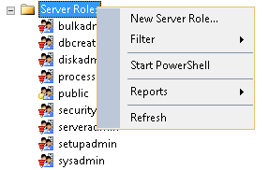
Managing Server-Level Roles
All server-level principals are members of the public server role
Assign logins to fixed server-level roles to delegate administrative tasks
Create user-defined server roles if fixed roles don’t meet your needs

Slide 13
Managing-Server Security

Slide 14
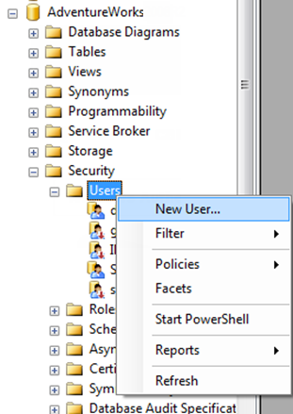
Managing Database Users
Logins cannot access a database to which they have not been granted access
Grant access to a login by creating a database user for it

Slide 15
Managing dbo and guest access
dbo database user
sa login, members of sysadmin role, and owner of the database map to the dbo account
Guest database user
Enables logins without user accounts to access a database
Disabled by default in user databases
Enabled by using the GRANT CONNECT statement

Slide 16
Database Ownership
Like other objects, databases have owners
A database owner will default to the user who created it
This user will map to the dbo user
Don’t have databases owned by user accounts

Slide 17
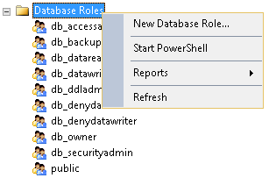
Managing Database-Level Roles
Assign users to fixed database-level roles to grant common permissions
Create user-defined roles for finer-grained permissions management

Slide 18
Managing Application Roles
Use an application role to switch security context
Often used for tasks that require elevated privileges
Create an application role with a password
Activate and deactivate an application role
CREATE APPLICATION ROLE sales_supervisor
WITH PASSWORD = 'Pa$$w0rd';
EXEC sp_setapprole 'sales_supervisor', 'Pa$$w0rd',
@fCreateCookie = true,
@cookie = @cookie OUTPUT;
...
EXEC sp_unsetapprole @cookie;

Slide 19
Using an Application Role

Slide 20
Managing Database Permissions
Statement Permission Govern DDL
Object Permissions Govern DDL and DML
GRANT CREATE TABLE TO db_dev;
GRANT ALTER ANY ROLE, ALTER ANY USER TO sales_admin;
GRANT ALTER APPLICATION ROLE::sales_supervisor
TO sales_admin;
GRANT SELECT ON OBJECT::dbo.ProductCategory
TO product_reader;
GRANT SELECT ON dbo.Product
TO product_reader;

Slide 21
Table and View Permission
SELECT
INSERT
UPDATE
DELETE
REFERENCES
Use column-level permissions for finer-grained control

Slide 22




Ownership Chains
dbo.View1 (User2)
dbo.Table1 (User2)
User 1
dbo.View2 (User2)
dbo.Table2 (User3)
When dependent objects are owned by the same user, only permissions at the top-level object are required
When there is a break in the ownership chain, dependent object permissions are required

Slide 23




Database Encryption
DPAPI (Windows)
Service Master Key (SMK)
Created during SQL Server Installation
Database Master Key (DMK)
Created in master database
Encrypted by SMK
Server Certificate
Created in master, encrypted by DMK
Database Encryption Key (DEK)
Created in user database, encrypted by Cert
SMK
master
master DMK
Server
certificate
User DB
DEK

Slide 24
Transparent Database Encryption

Slide 25
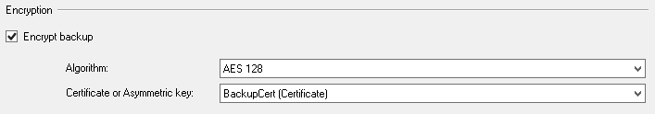
Backup Encryption
Create a database master key for master
Create a certificate or asymmetric key
Back up the database, specifying the algorithm and key
BACKUP DATABASE AdventureWorks
TO DISK = 'R:\Backups\AW_Encrypt,bak'
WITH FORMAT, INIT,
ENCRYPTION( ALGORITHM = AES_128,
SERVER CERTIFICATE = [BackupCert])

Slide 26
Backup Encryption

Slide 27
Designing Database Security
Summary
Introduction to SQL Server Security
Managing Server-Level Security
Managing Database-Level Principals
Managing Database Permissions
Encryption methods and scenarios

